Slide 1

Ai & Large language models (llm) in healthcare Lei li, PhD

Slide 2

Agenda
What is AI and LLM
Technical Details of LLM
How can LLM be applied to HealthCare
Limitations
Summary

Slide 3
Large language models

Slide 4
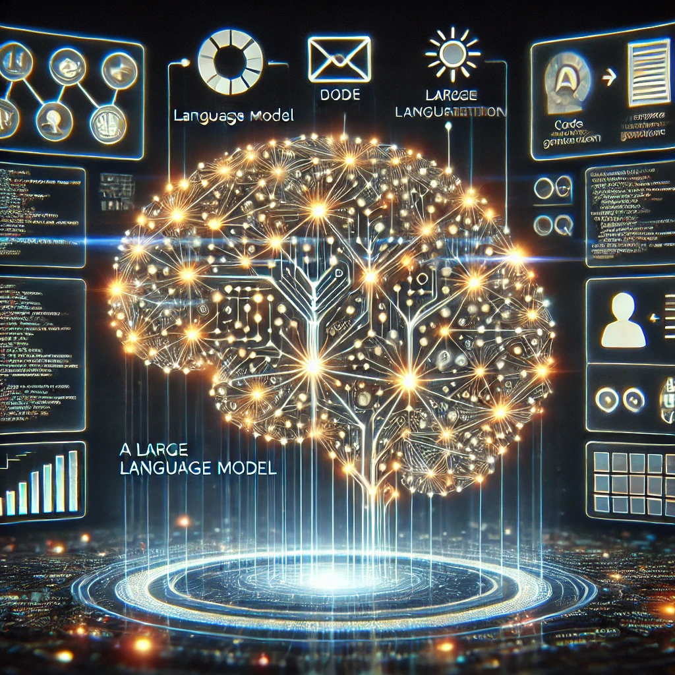
What is AI & large language models (llm)
What is AI: WIKIPEDIA: “Artificial intelligence (AI), in its broadest sense, is intelligence exhibited by machines, particularly computer systems. It is a field of research in computer science that develops and studies methods and software that enable machines to perceive their environment and use learning and intelligence to take actions that maximize their chances of achieving defined goals.”
What is LLM: GhatGPT: Large language models (LLMs) are a type of artificial intelligence (AI) that can understand and generate human language.
Text generation
Image generation
Language translation
Speech recognition
Code generation
Technically, The LLM is based on the Transformer Model Architecture (i.e., a type of Neural Networks) which consists of Encoder and Decoder.
The popular apps include ChatGPT (OpenAI, 1.74 trillion parameters), Bard/Bert/Gemini (Google), Claude (Anthropic), Llama (Meta), etc.
Prompt: “Can you produce a simple and beautiful image for illustrating what large language model can do?”
Ref: Vaswani, A., 2017. Attention is all you need. Advances in Neural Information Processing Systems.
Notes:
For the picture: “It shows a futuristic neural network with glowing nodes and various applications, such as writing and code generation.”

Slide 5
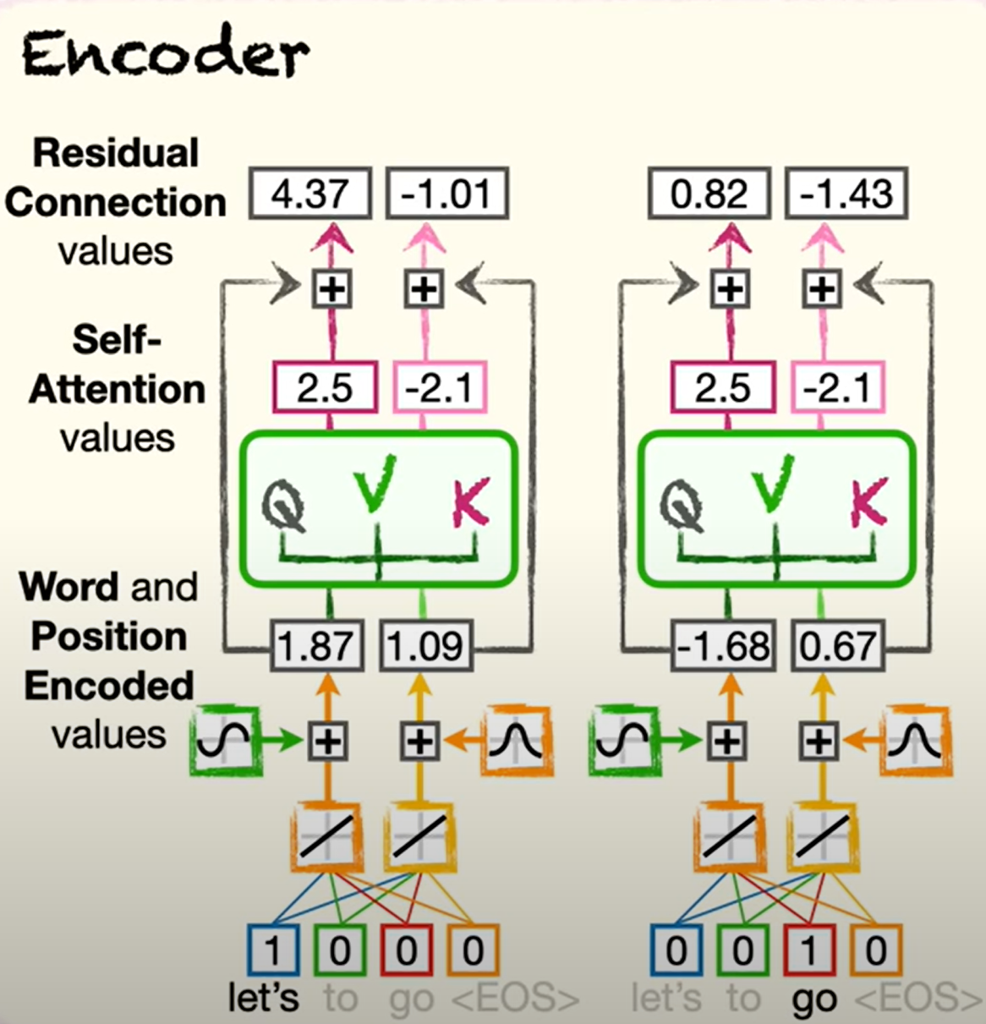
LLM Technical Details: encoder
The LLM is based on the Transformer Model Architecture which consists of Encoder and Decoder. Example in translation: Let’s go ➔ Vamos
Encoder: used to process an input sequence (e.g., English)
Encode the words into numbers (Embedding): e.g., Let’s go ➔ ((1, 0, 0, 0), (0,0,1,0))
Encode the position of the words into numbers (Positioning) e.g., Let’s go ≠ Go let’s ((1.87, 1.09), (-1.68, 0.67))
Encode the words relationships in a sentence (within the input) into numbers through the metric “similarities” (Self-Attention). E.g., I have a bunch of roses in my office and it smells good. ((2.5, -2.1), (2.5, -2.1))
Add them up (Residual Connections)
Notes:
For the picture: “It shows a futuristic neural network with glowing nodes and various applications, such as writing and code generation.”

Slide 6
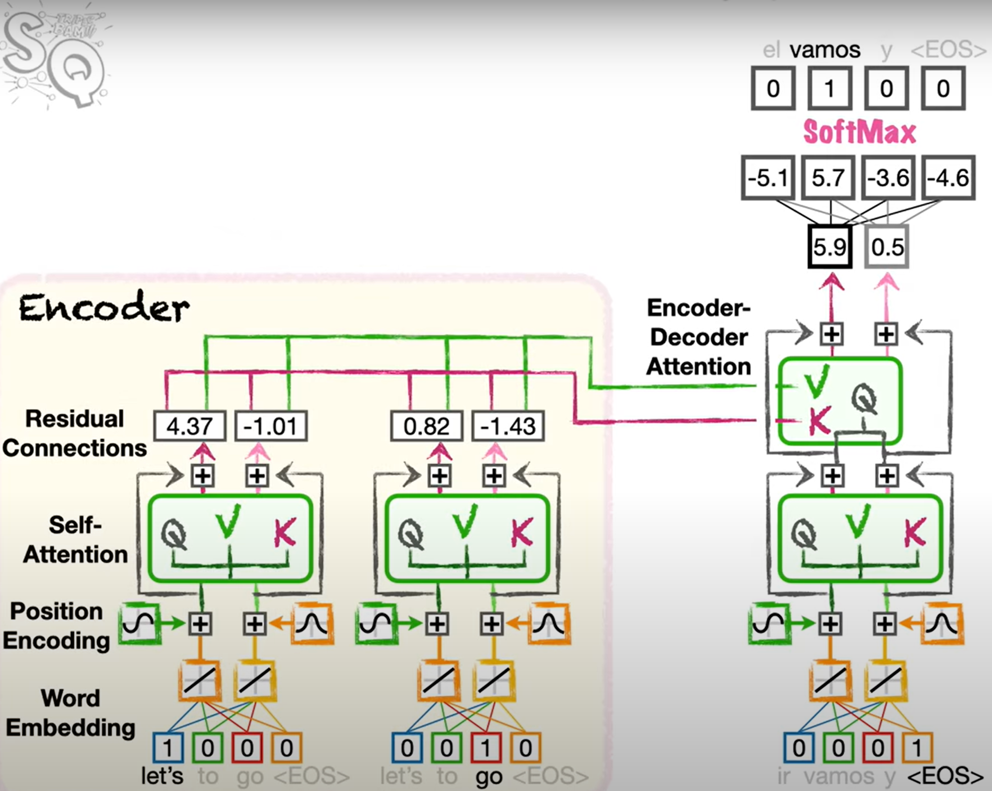
LLM Technical Details: Decoder
Example in translation: Let’s go ➔ Vamos
Decoder: ued for generating or predicting sequences of text based on the encoded information from the input sequence
Start with the [EOS]: End of Sentence, do the word embedding, positioning, and self attention as Encoder does.
Assessing the relationship between encoder and [EOS], by performing Encoder-Decoder relation. The purpose is to focus on the relationship between output words and input words. E.g., Let’s go vs [EOS]
Run the neural networks to get the selected words (e.g., vamos)!
Repeat the above three steps until reaching [EOS] again.
Decoding Process
Notes:
For the picture: “It shows a futuristic neural network with glowing nodes and various applications, such as writing and code generation.”

Slide 7
Fine tuning of llm models
General LLM is a broad model that may not be suitable for a particular area (e.g., pharma/vaccine), so it needs some tuning for better performance. Examples of fine tuning include full fine-tuning, adapter layers, LoRA (Low-rank adaptation), prompt engineering,
Prompt Engineering Principles
Provide clear and specific instructions (e.g., Use delimiters to clearly indicate distinct parts of the input; use structured outputs)
Give the model time to think
“Few-shot” prompting:
Give successful examples of completing tasks then ask model to perform the task.
Could be potentially used in automating/piloting programming process.
Example of Prompt Engineering:
text = f"""You should express what you want a model to do by \ providing instructions that are as clear and \ specific as you can possibly make them. \ This will guide the model towards the desired output, \ and reduce the chances of receiving irrelevant \ or incorrect responses. Don't confuse writing a \ clear prompt with writing a short prompt. \ In many cases, longer prompts provide more clarity \ and context for the model, which can lead to \ more detailed and relevant outputs.
"""
prompt = f"""Summarize the text delimited by triple backticks \ into a single sentence.```{text}```""“
print(response)
Providing clear and specific instructions to a model will guide it towards the desired output, reducing the chances of irrelevant or incorrect responses, and longer prompts can provide more clarity and context for more detailed and relevant outputs.
Notes:
Adapter layers: only small additional neural layers are inserted into the model, and only these layers are trained.

Slide 8
Applications in healthcare

Slide 9
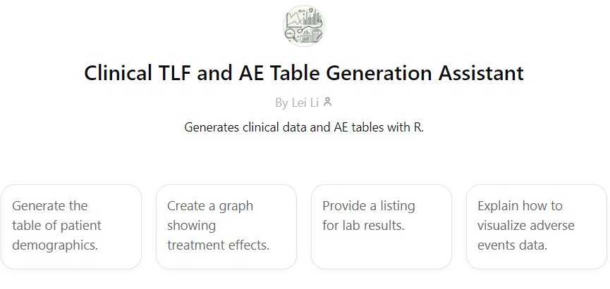
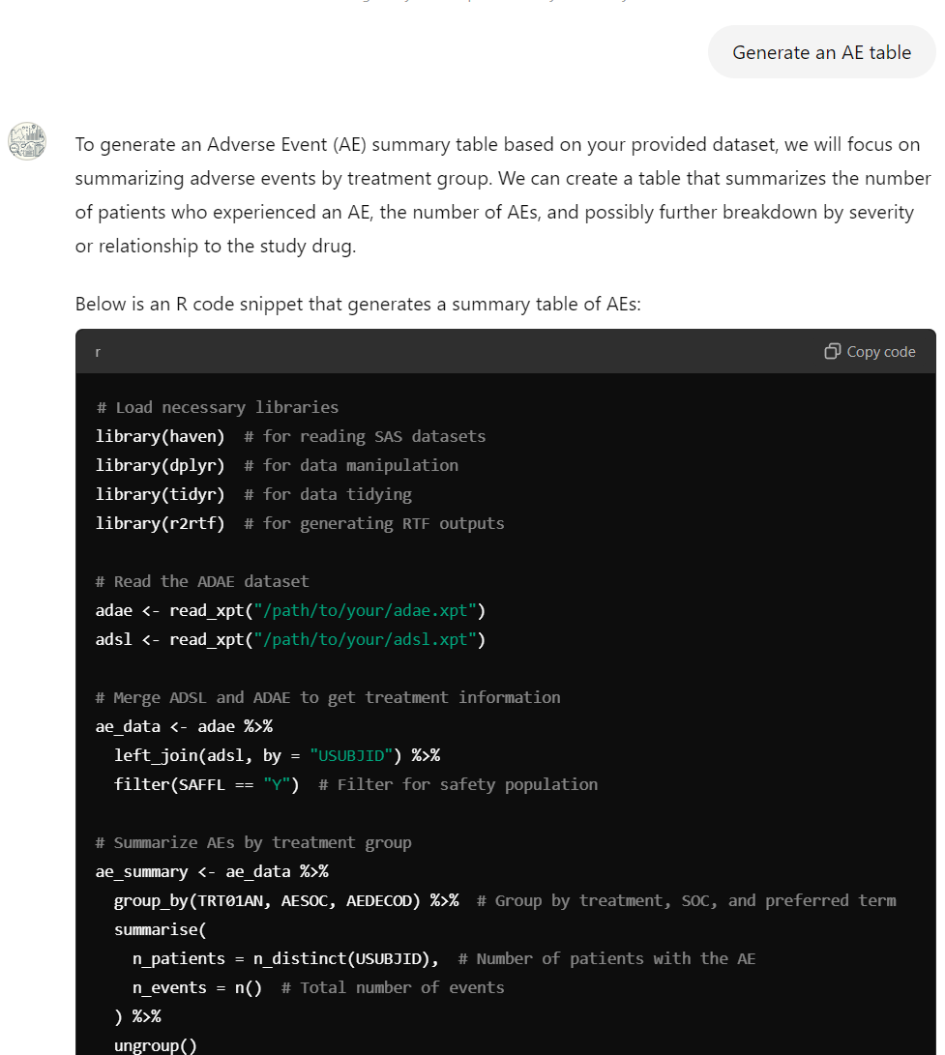
“Few-shot” prompting with application to programming
Main Idea: provide examples of datasets (e.g., adsl, adae, etc), examples of TLFs, and examples of the codes generating them (e.g., TALISMA at Sanofi), then give “few-shots” for each of the TLF desired (e.g., disposition table), in a structured way. Then the LLM will produce what you want.
Key point: make the training data in a machine (i.e., LLM) understandable way.
Potential automation process: Raw data ➔ SDTM ➔ ADAM ➔ TLF
Example: Generate an AE table: Prompt:
Example: https://chatgpt.com/share/66f619a9-2a50-8000-8be4-ba695f21b99a
Notes:
Adapter layers: only small additional neural layers are inserted into the model, and only these layers are trained.

Slide 10
“Few-shot” prompting challenges in automating programming
Challenges:
Difficult to make the training data “machine-understandable.” For instance, the machine needs to comprehensively understand the combination of data specs, the Meddra coding, guidance, human language comments, notes, etc. Putting them together structurally is challenging.
Training data in different project/study varies a lot, making the model training process surprisingly long.
Potential Solutions:
Build a new LLM model desired specifically for automating these programming tasks (con: costly).
Other fine tuning techniques such as adapter layers can be investigated as well.
Training data example: ADSL
Text for training:
The following R codes will generate the table of 2.1.1 Analysis of Demographic Characteristics in Safety Population.
This code below will update the age categories to "18 to 29" and ">=30”, and generate table 2.1.2 Analysis of Demographic Characteristics in Safety Population.
This code below will update to let the mean be displayed in 2 decimal places, and generate table 2.1.3 Analysis of Demographic Characteristics in Safety Population
Notes:
Adapter layers: only small additional neural layers are inserted into the model, and only these layers are trained.

Slide 11
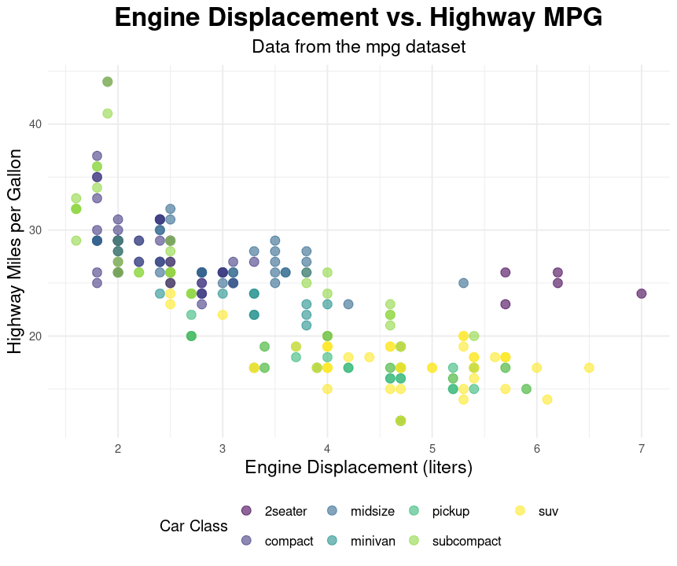
Llm with clinical studies other useful areas
Literature Review Automation. E.g., Clinical team search for translational study literature review.
New Drug Discovery: ChemCrow, for instance, is an LLM designed for drug discovery, organic synthesis, and material design, integrating expert-designed tools for enhanced performance in chemistry-related tasks.
Patient-Doctor Consultation: LLMs can assist with summarizing clinical notes during patient consultations, reducing administrative burden.
Biostats Clinical Decision:
Go/No-Go decision (e.g., POC study)
Help determine/choose most appropriate statistical models (e.g., Frequentist/Bayesian)
Help draft SAPs
R packages calling LLM (e.g., gpt): chattr ➔ pilot R code generation for data analysis, etc.
https://cran.r-project.org/web/packages/chattr/index.html
Existing tools: ClinicalGPT:
Medical Documentation and Note Generation
Diagnostic Support and Imaging Interpretation
Handling Medical Literature and Research
Prompt: In mpg dataset, can you analyze with plot the engine displacement vs Highway MPG by class? Also, please provide all codes.
Notes:
LLM automate the literature review process, aiding researchers in quickly identifying and analyzing relevant studies, thereby saving time and human resources.
New Drug Discovery:
Use case: A doctor enters symptoms like chest pain, difficulty breathing, and fatigue into an LLM-based system. The LLM correlates these with the patient's medical history and suggests possibilities like heart disease or a respiratory condition, offering relevant diagnostic tests or treatment options based on clinical studies.
Use case: During a patient visit, an LLM automatically records the conversation and generates a structured clinical note that includes the patient's symptoms, diagnosis, and treatment plan. This reduces the time clinicians spend on paperwork.

Slide 12
Limitations and summary

Slide 13
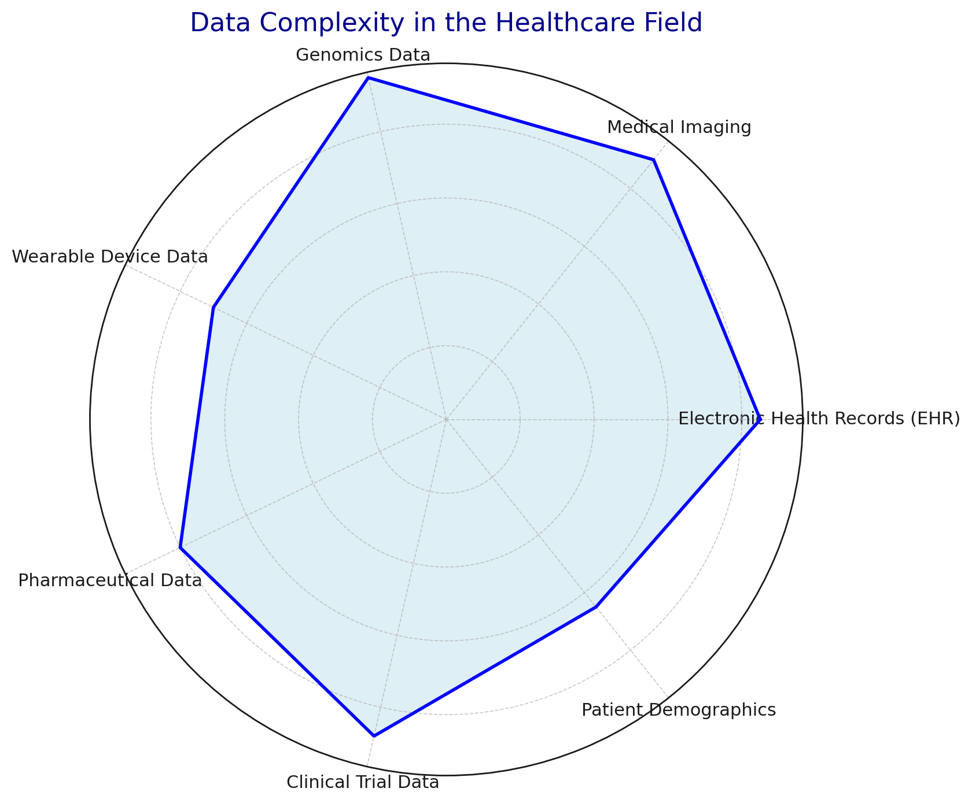
Limitations
Insufficient Accuracy: E.g., Hallucinations, sometimes LLMs make stuff up; difficulty in understanding long context, etc.
Low Quality of Data: The healthcare domain encompasses a wide array of data formats, ranging from structured text data to unstructured
Lack of Interpretability: E.g., Decision making process for M0, Phase I/II, and Phase III/IV.
Privacy and Data Security: Employing medical LLM may involve the transmission and storage of sensitive patient consultation data and confidential medical personnel information. No mature regulation standards existing in this matter now.
Notes:
1. Lack of long-term memory and learning, Limited reasoning – LLMs struggle complex multistep problems, Limited Knowledge: LLMs can’t update it’s knowledgebase.
4. Employing medical LLM may involve the transmission and storage of sensitive patient consultation data and confidential medical personnel information. It is imperative to implement robust measures to safeguard data security and ensure the anonymity of sensitive information. Data encryption technology should be applied to fortify the security and privacy of user data.

Slide 14
Summary
LLM is a powerful tool and is being used in a lot of healthcare fields.
There are many limitations in the implementation of healthcare applications
Wait for AGI (Artificial General Intelligence)?!
Notes:
1. Lack of long-term memory and learning, Limited reasoning – LLMs struggle complex multistep problems, Limited Knowledge: LLMs can’t update it’s knowledgebase.
4. Employing medical LLM may involve the transmission and storage of sensitive patient consultation data and confidential medical personnel information. It is imperative to implement robust measures to safeguard data security and ensure the anonymity of sensitive information. Data encryption technology should be applied to fortify the security and privacy of user data.

Slide 15
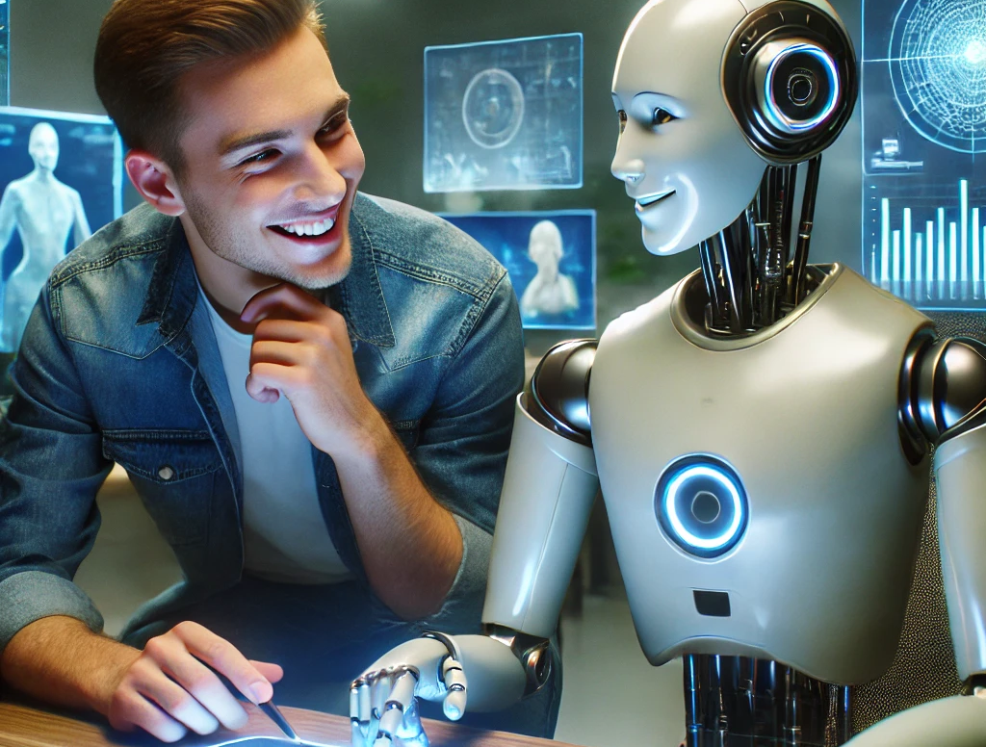
Thank you
Lei Li

Slide 16
References
Vaswani, A., 2017. Attention is all you need. Advances in Neural Information Processing Systems.
Notes:
1. LLM automate the literature review process, aiding researchers in quickly identifying and analyzing relevant studies, thereby saving time and human resources.

